Slide 1
Auto Sailor
CS5100 Final Project
Jasmine Owens, Srikanth Bonkuri, Josh Nougaret, Yue Yao
2023-12-12

Slide 2
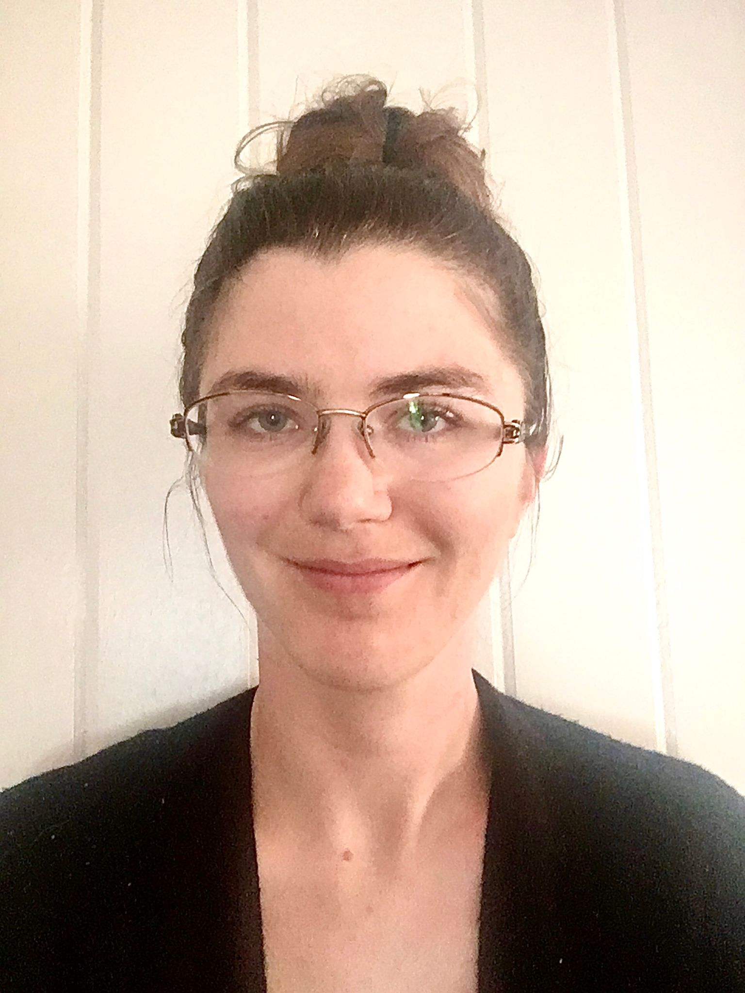
CONTENTS
Introduction
Project Strategy
Agent Overview
Agent Details
Conclusion
Notes:
In this presentation, we will discuss the process of designing and implementing an Auto Sailor AI agent. We will begin with the basis of the project, discuss how existing sail navigation software influenced our designs, demonstrate our implementations, and present our results.

Slide 3
Introduction
Auto Sailor aims to develop an autonomous sailing agent for a browser-based sailing game.
Normal gameplay involves a player adjusting the vessel’s heading and sail position using key binds.
Auto Sailor will access the same levers behind the scenes to navigate the vessel to a specified point.
We assessed a variety of search strategies and will present the results for each.
01
Notes:
[read slide]

Slide 4

Project Strategy
Our objective is for Auto Sailor to navigate to a fixed point in the absence of obstacles.
Downwind travel is trivial: adjust the heading directly towards the target.
Upwind travel is complex: the agent must navigate through some intermediate point not on the direct path.
Existing commercial autonomous navigation software mostly focuses on staying on a path and collision avoidance.
The Auto-Sailor environment can be modeled similarly to Pacman, with a list of available actions and a search. This is the approach we chose.
02
Notes:
[read slide]

Slide 5

Agent Overview
To simplify the problem, Auto Sailor reflexively calculates the best sail angle based on the vessel’s heading.
Auto Sailor’s only decision-making power is to set the vessel’s heading (Left, Right, or Ahead).
Auto Sailor has full access to the vessel and wind information. It can use these to calculate future states for the available actions.
States are evaluated using the vessel’s distance from the target and radial velocity towards the target as heuristics.
03
Notes:
[read slide]

Slide 6

Agent Details
We created four different agents for this project:
Reflex Agent
Greedy Depth-Limited Search
Depth-Limited Search
A*
We will demo each agent, describing the strategy and implementation of each.
04
Notes:
[read slide]

Slide 7
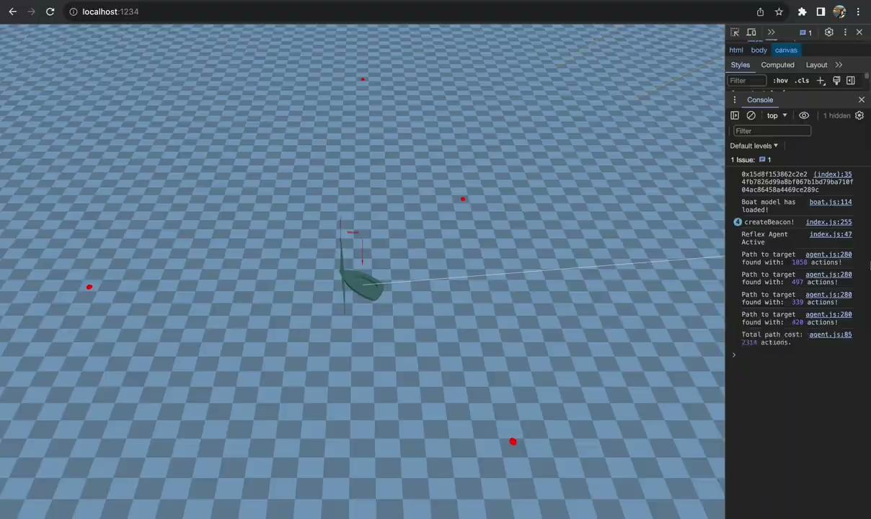
Agent Details: Reflex Agent
Pros:
Fast
Cons:
Complicated casing
Suboptimal routing
Notes:
We first created a reflex agent to use for comparison to our search agents.
Our reflex agent generates a set of three future states, based on the action list. The agent then chooses the action that produces the maximum radial velocity towards the target. The choice is tempered by a turning penalty which is intended to discourage the agent from quick turns at high speed.
The reflex agent successfully navigates to the target, but is supported by complicated casing in the code. The route it produces is also not optimal.

Slide 8
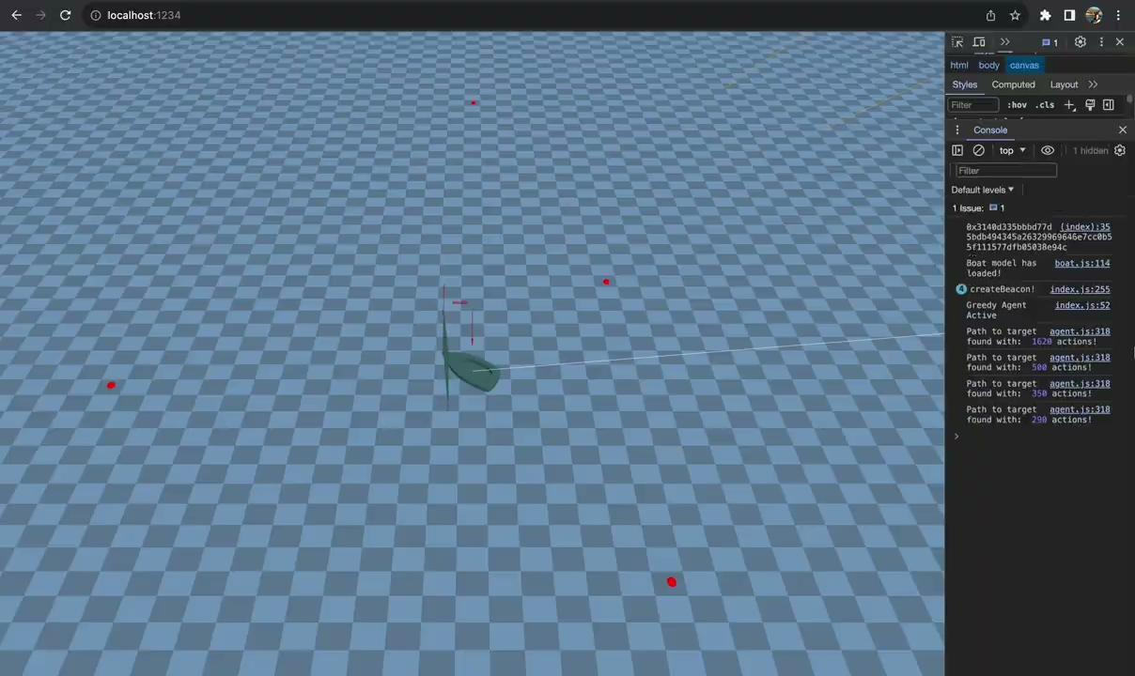
Agent Details: Greedy DLS
Pros:
Reaches goal upwind
Cons:
Suboptimal pathing
Long calculation
Notes:
Next we will present our greedy depth-limited search agent.
Our greedy DLS agent recursively creates a search tree, and at each step, chooses the locally best result based on Manhattan distance. The depth of the search tree is limited dynamically. When the vessel is farther away from the target, it generates a longer tree. The idea is that nearer the target, fewer actions are needed to successfully navigate.
You can see on the demo that the agent chooses to turn very far away from the target point, which is not optimal. This is because the agent makes greedy decisions, not considering long-term payoff. The agent is also considerably slower to run than the reflex agent.
So greedy depth-limited search is not a very good approach. We next implemented depth-limited search.

Slide 9
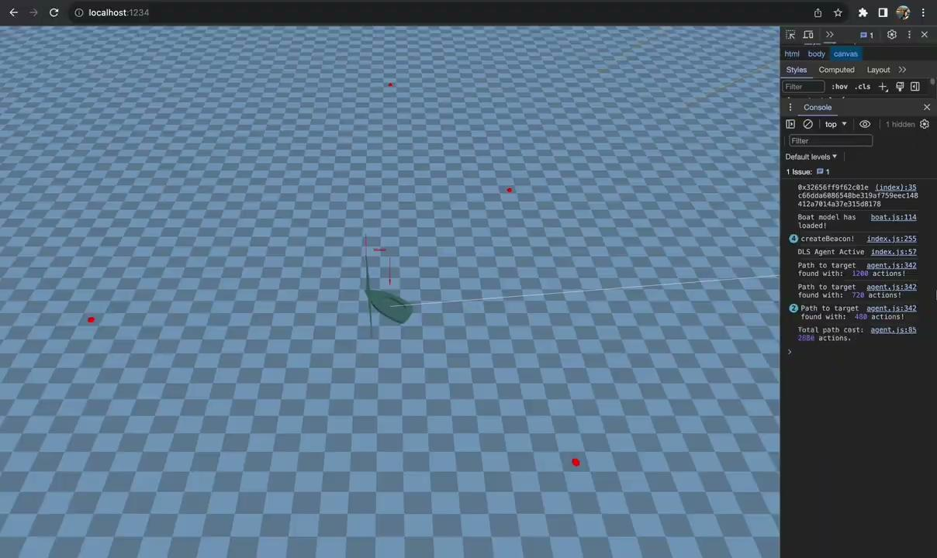
Agent Details: DLS
Pros:
Less jitter and better pathing than greedy
Cons:
Slowest start-up
Notes:
This was an improvement over greedy depth-limited search.
The DLS agent uses a priority queue to manage states and choose the best actions, and otherwise is similar to greedy DLS. The results of the DLS agent are slightly better than the greedy DLS agent, but it is noticeably slower to run.
We made a number of modifications to this one in an effort to speed it up, but in the end the slow start-up time makes it unsuitable for a game environment.
This would maybe be a valid approach if we figured out some sort of pruning criteria, but that would require a lot of tweaking and testing. And we still wanted to implement A*.

Slide 10
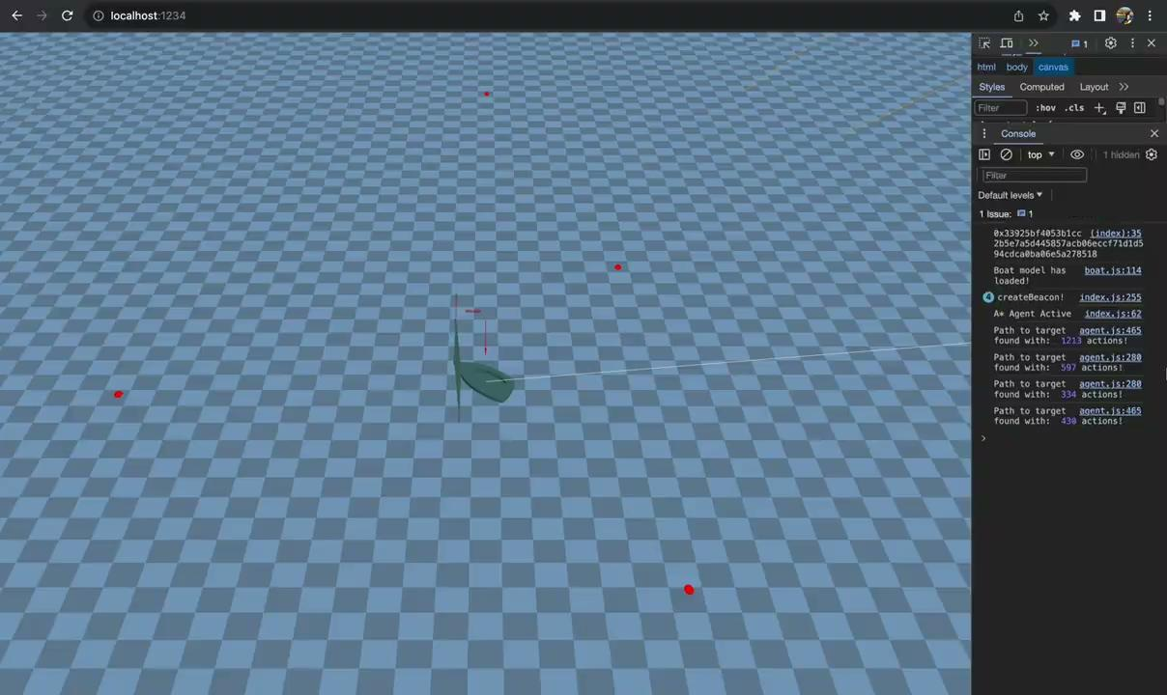
Agent Details: A*
Pros:
Fast
Effective
Cons:
Code is complicated
Notes:
A-star was the most effective agent we implemented.
Our A-star agent performs the search using a priority queue in heap memory, and is the most efficient search algorithm we implemented.
The A-star agent is nearly as fast as the reflex agent. In fact when the boat does not need to turn, because it is headed downwind, the A-star agent uses the reflex agent instead of doing costly calculations.
The agent does tack more frequently that perhaps might be ideal in a real sailboat, but this behavior can likely be modified by either adjusting the game physics or by adjusting the objective function.

Slide 11
Conclusion
The Auto Sailor A* search agent meets all the initial requirements of the project, which was to create an agent that can successfully navigate the boat to a set point.
We demonstrated all agents that we created because we believe there is value in seeing how the different strategies can be used to solve the same problem.
Further development of the AI agent may look into alternative heuristics or transition models.
05
Notes:
In conclusion, the A-star search agent meets all the initial requirements of the project, which was to create an agent that can successfully navigate the boat to a set point.
We demonstrated all agents that we created because we believe there is value in seeing how the different strategies can be used to solve the same problem.
Further development of the AI agent may look into alternative heuristics, and may also look at alternatives in transition models.
Overall we are very pleased with the outcome of this project. We learned alot while implementing the different agents and tuning their behavior to the specific needs of the game.

Slide 12
THE END
THANKS
Notes:
This concludes the presentation. Thank you.

